Slide 1
Lecture 11: ETL Subsystems, Techniques and System Design
Chapter 19 and Chapter 20

Slide 2
ETL Process
What does ETL stands for?
Extract, Transformation, and Load
Extracting: Gathering raw data from source system and writing it to disk
Transformation: Rules and regulations can be applied that ensure data quality and accessibility. Apply rules to help your company meet reporting requirements.
Sub-systems: Cleansing; Standardization; Deduplication; Verification; Sorting; Other tasks;
Load: load the newly transformed data into a new destination. Data can be loaded all at once (full load) or at scheduled intervals (incremental load);

Slide 3
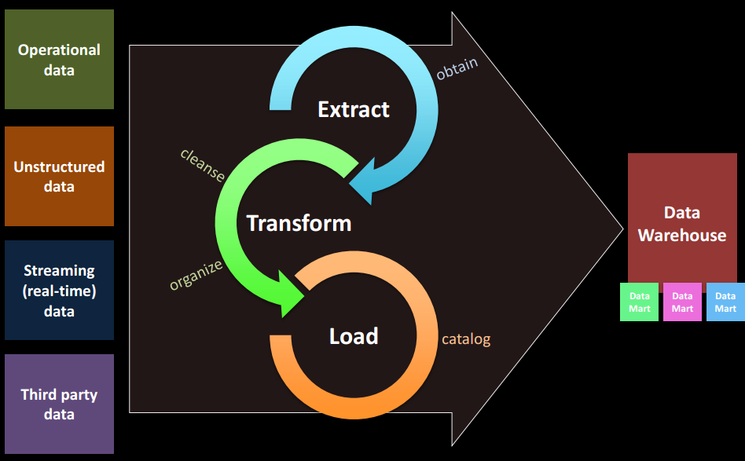
ETL Process

Slide 4
﻿Ten Requirements for ETL
1. ﻿Business Needs
﻿The information content that business users need to make informed business decisions;
2. ﻿Compliance
﻿list all data and final reports subject to compliance restrictions.
3. ﻿Data Quality
﻿List those data elements whose quality is known to be unacceptable.
4. ﻿Security
﻿data should be restricted to those with a need to know; ﻿
physical backups;
﻿5. Data Integration
conforming dimensions and conforming facts in the data warehouse;
6. Data Latency
﻿how quickly source system data must be delivered to the business users via the DW/BI system.

Slide 5
Ten Requirements for ETL (cont…)
7. Archiving and Lineage
﻿staging the data (writing it to disk) after each major activity of the ETL pipeline;
8. BI Delivery Interfaces
ETL team should work closely with modeling team;
List all facts and dimension tables;
9. Available Skills
﻿ETL tool, scripting language, programming language, SQL, DBMS, and OLAP skills
10. Legacy Licenses
Legacy Licenses are historical licenses (a license type that is no longer offered and so cannot be renewed)

Slide 6
﻿The 34 Subsystems of ETL
﻿34 critical subsystems that form the architecture for every ETL system;
Major components:
﻿Extracting: ﻿Gathering raw data from the source systems and writing it to disk in the ETL environment before any significant restructuring (Subsystems 1 to 3);
Cleaning and conforming: Improve the quality of the data received from the source, and merging data from two or more sources to create and enforce conformed dimensions and conformed metrics (Subsystems 4 to 8);

Slide 7
The 34 Subsystems of ETL cont.
﻿Delivering: Physically structuring and loading the data into the presentation server’s target dimensional models (Subsystems 9 to 21);
Managing: Managing the related systems and processes of the ETL environment in a coherent manner (Subsystems 22 to 34);

Slide 8
Subsystems of ETL
Extracting
Subsystem 1: Data Profiling
Describe the contents, consistency, and structure (e.g. SELECT DISTINCT)
Provides information about data cleaning requirements
﻿Plays two distinct roles: strategic and tactical.
﻿Determine data source’s suitability for inclusion in the data warehouse and provide an early go/no go decision.
Protects from missing major project milestones due to the unexpected diversion of building systems to deal with dirty data;

Slide 9
Subsystems of ETL
Extracting
2. Subsystem 2: Change Data Capture System
Isolate the latest source data
Just transfer the data that has changed since the last load
Audit columns – stores date and time of each modification of a record
Timed Extract – Time based selection is not recommended; Time-based data selection loads duplicate rows when it is restarted from mid-process failures; if the load process fails to run and skips a day, missed data will be missed forever;
Full Diff Compare – identify the change by comparing record by record; Very resource-intensive; Cyclic redundancy checksum (CRC) algorithms;

Slide 10
Subsystems of ETL
Extracting
Subsystem 3: Extract System
Each source might be in a different system, environment or DBMS
Create MapReduce/Hadoop extract step to extract unstructured, semistructured “Big Data”.
﻿Data compression is important if large amounts of data need to be transferred over a significant distance or through a public network.
﻿Data encryption is important if data is transferred through a public network, or even internally in some situations.

Slide 11
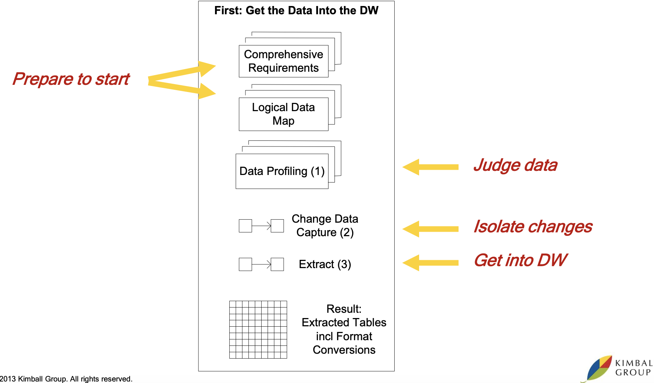
Subsystems of ETL: Extracting

Slide 12
Subsystems of ETL
Cleaning and Conforming Data
Subsystem 4: Data Cleansing System
﻿Cleansing data, capturing data quality events, as well as measuring and ultimately controlling data quality in the data warehouse.
﻿Quality Screens -> Each quality screen is a test. diagnostic filters in the data flow pipelines; Column screens and Structure screens;
﻿Responding to Quality Events: Successful test -> nothing happens; Failed test -> actions: drop an error event, halt the process, send the oﬀending data into suspension, tag the data;

Slide 13
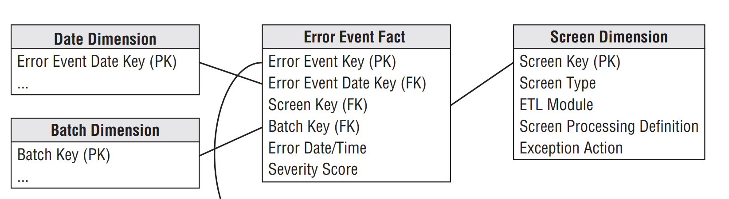
Subsystems of ETL
Cleaning and Conforming Data
5. Subsystem 5: Error Event Schema
Record every error event identified by quality screen
﻿The fact table’s grain is every error thrown (produced) by a quality screen anywhere in the ETL system.

Slide 14
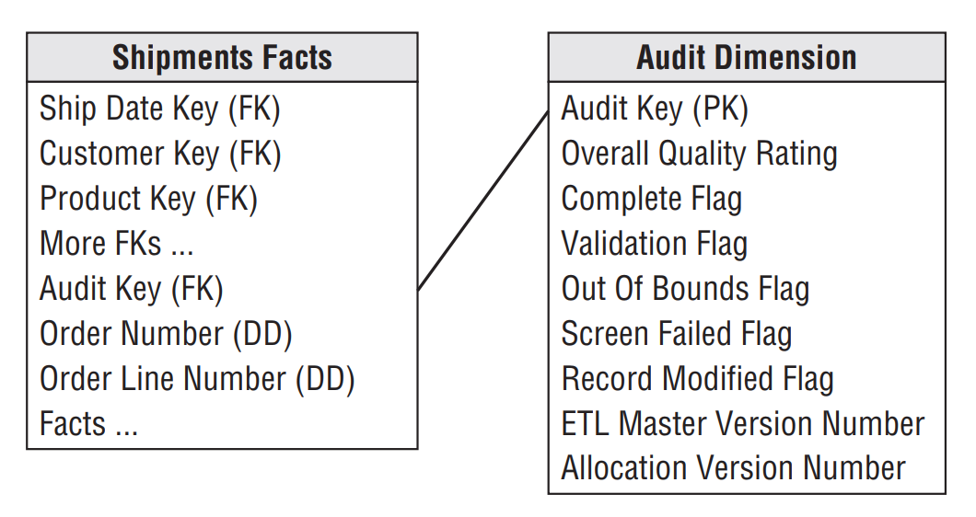
Subsystems of ETL
Cleaning and Conforming Data
6. Subsystem 6: Audit Dimension Assembler
﻿The audit dimension is a special dimension that is assembled in the back room by the ETL system for the fact table;

Slide 15
Subsystems of ETL
7. Subsystem 7: ﻿Deduplication System
﻿Often dimensions are derived from several sources.
Customer information may need to be merged from several lines of business and outside sources.
8. Subsystem 8: ﻿﻿Conforming System
﻿Align the content of some or all the columns in a dimension with columns in similar or identical dimensions in other parts of the data warehouse.

Slide 16
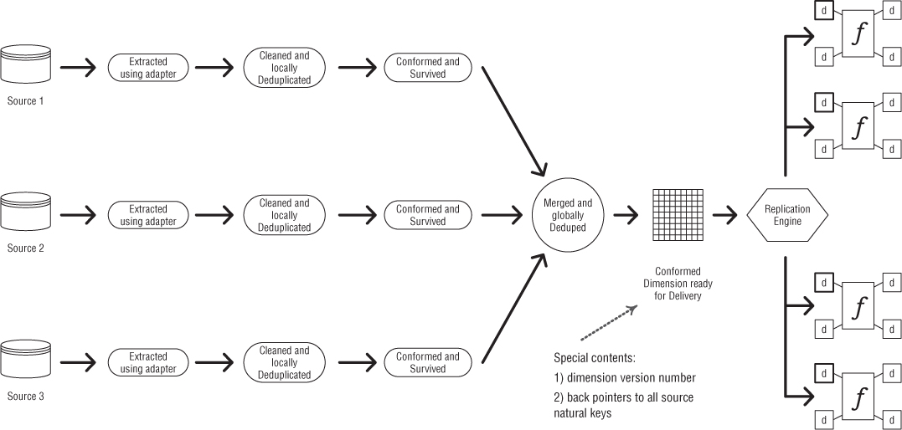
Subsystems of ETL: Conforming System

Slide 17
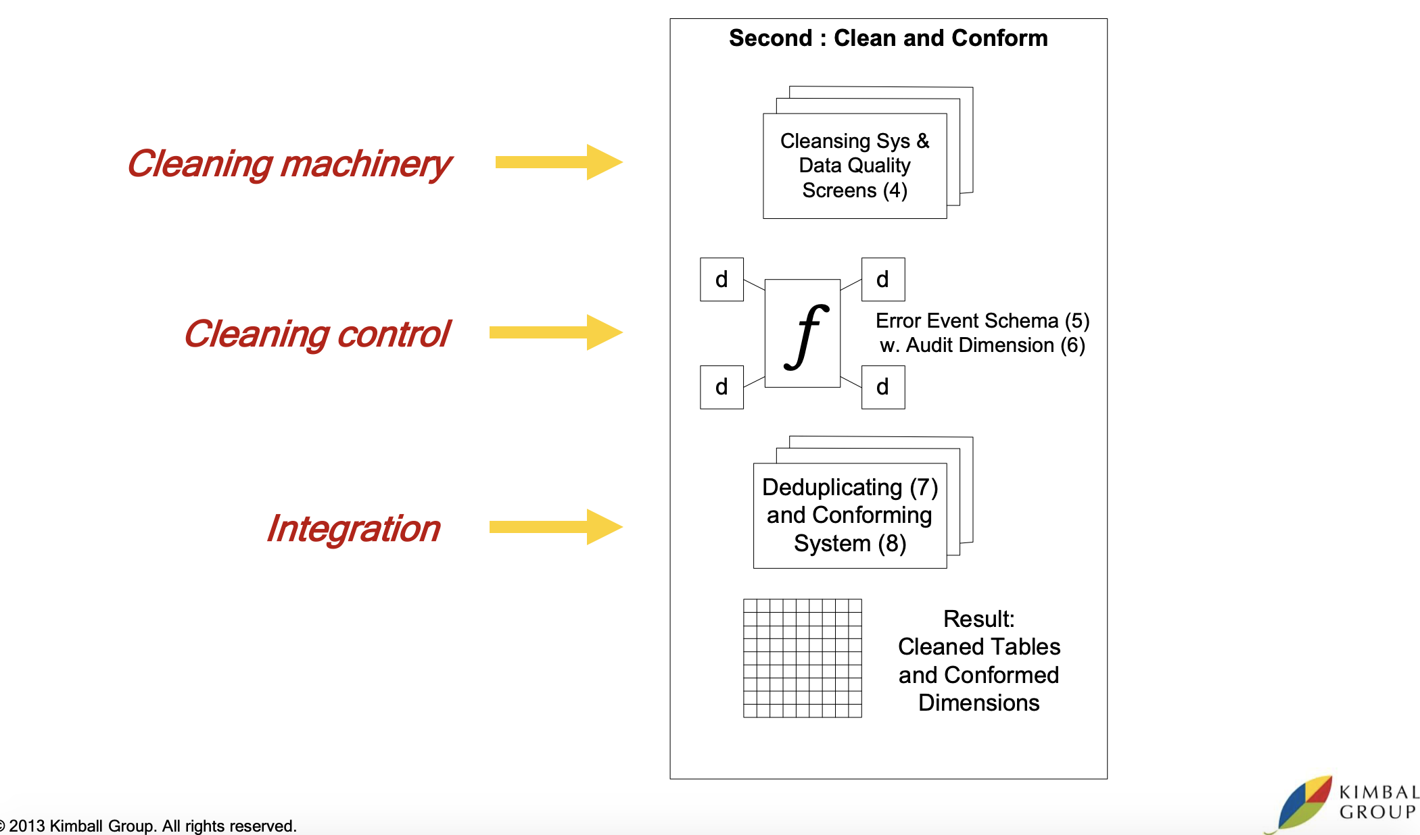
Subsystems of ETL: Cleaning and Conforming Data

Slide 18
﻿Subsystems of ETL
Delivering: Prepare for Presentation:
﻿The primary mission of the ETL system is the handoﬀ of the dimension and fact tables in the delivery step.
9. Subsystem 9: Slowly Changing Dimension Manager
The ETL system must determine how to handle an attribute value that has changed from the value already stored in the data warehouse.
If the revised description is determined to be a legitimate and reliable update to previous information, the appropriate SCD technique must be applied.

Slide 19
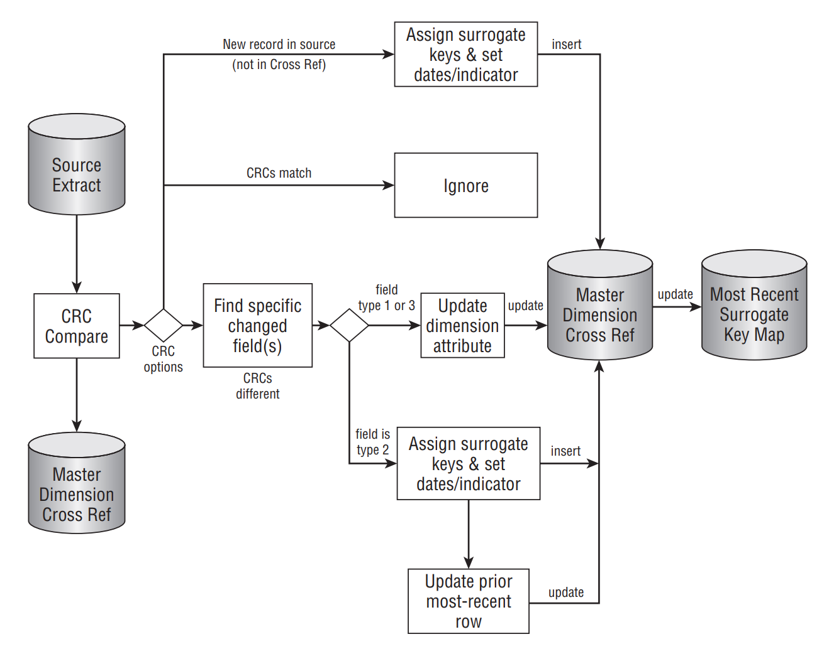
﻿Processing flow for SCD surrogate key management

Slide 20
Subsystems of ETL
Delivering
10. Subsystem 10: Surrogate Key Generator
The goal of the surrogate key generator is to generate a meaningless key, typically an integer, to serve as the primary key for a dimension row.
Database triggers;
Database sequence generator;
11. Subsystem 11: Hierarchy Manager
﻿Enforcing the business rules to assure the hierarchy is populated appropriately in the dimension table

Slide 21
Subsystems of ETL
Delivering
12. Special Dimensions Manager
The special dimensions manager is a catch-all subsystem: a placeholder in the ETL architecture for supporting an organization’s specific dimensional design characteristics.
﻿Date/Time Dimensions: specified at the beginning of the data warehouse project, and they don’t have a conventional source;
﻿Junk Dimensions; Mini-Dimensions; Shrunken Subset Dimensions;

Slide 22
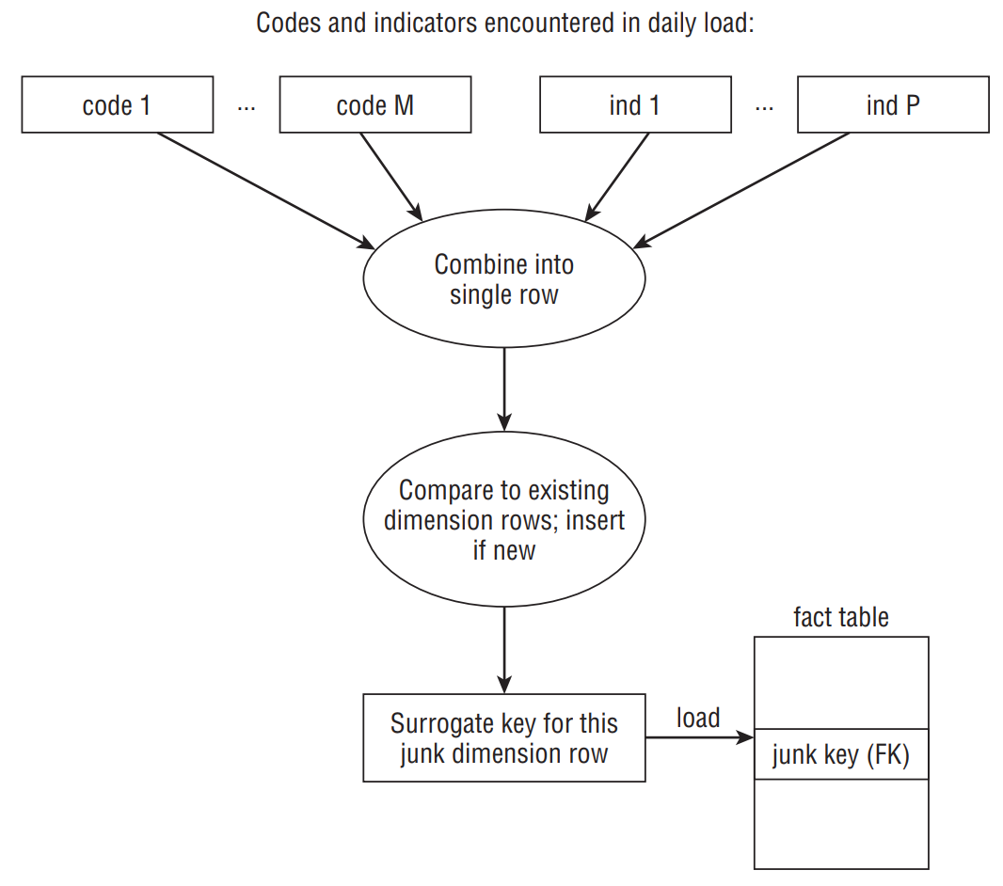
﻿Architecture for building junk dimension rows

Slide 23
Subsystems of ETL
Delivering
13. Subsystem 13: Fact Table Builders
Transaction Fact Table Loader: The transaction fact table loader receives data from the changed data capture system and loads it with the proper dimensional foreign keys.
Periodic Snapshot Fact Table Loader: All records for each periodic load can cluster in the most recent time partition. Traditionally, periodic snapshots have been loaded at the end of the appropriate period;
Accumulating Snapshot Fact Table Loader: Any changes would lead to destructively modified rows; The date foreign keys are overwritten, and various facts are updated; Use variable row lengths;

Slide 24
Subsystems of ETL
Delivering
14. Subsystem 14: Surrogate Key Pipeline
Replacing the operational natural keys in the incoming fact table row with the appropriate dimension surrogate keys;
The key lookup process should result in a match for every incoming natural key or a default value.

Slide 25
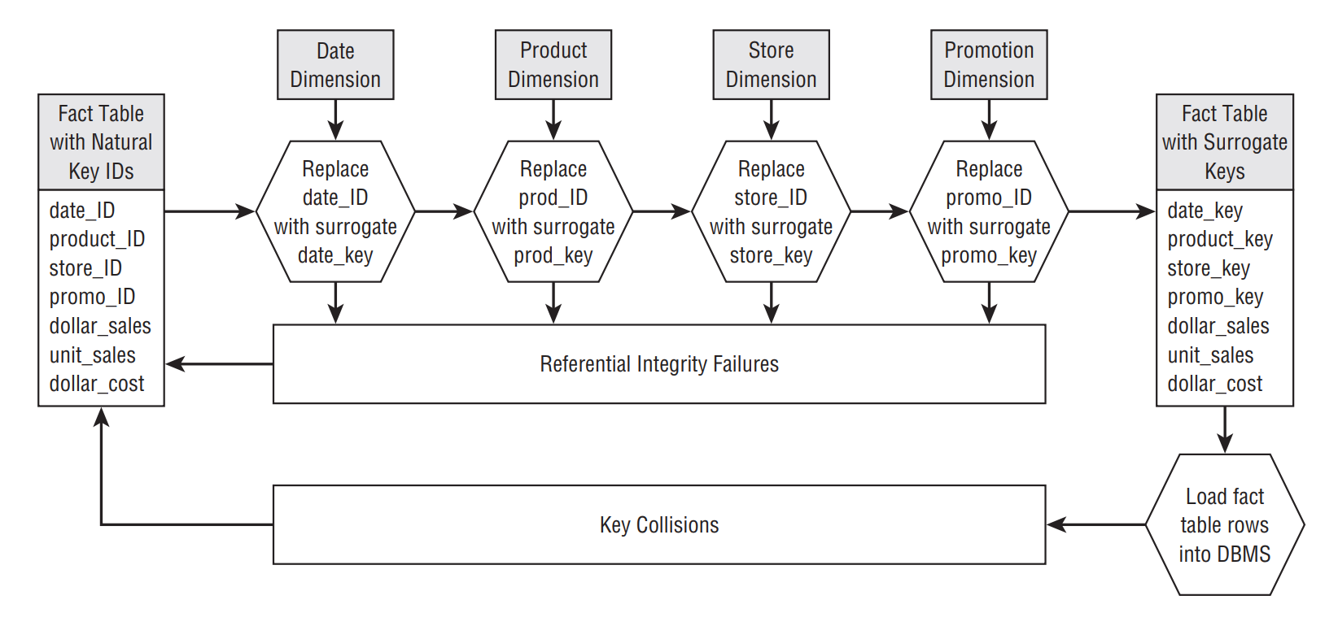
﻿Replacing fact record’s operational natural keys with dimension surrogate keys

Slide 26
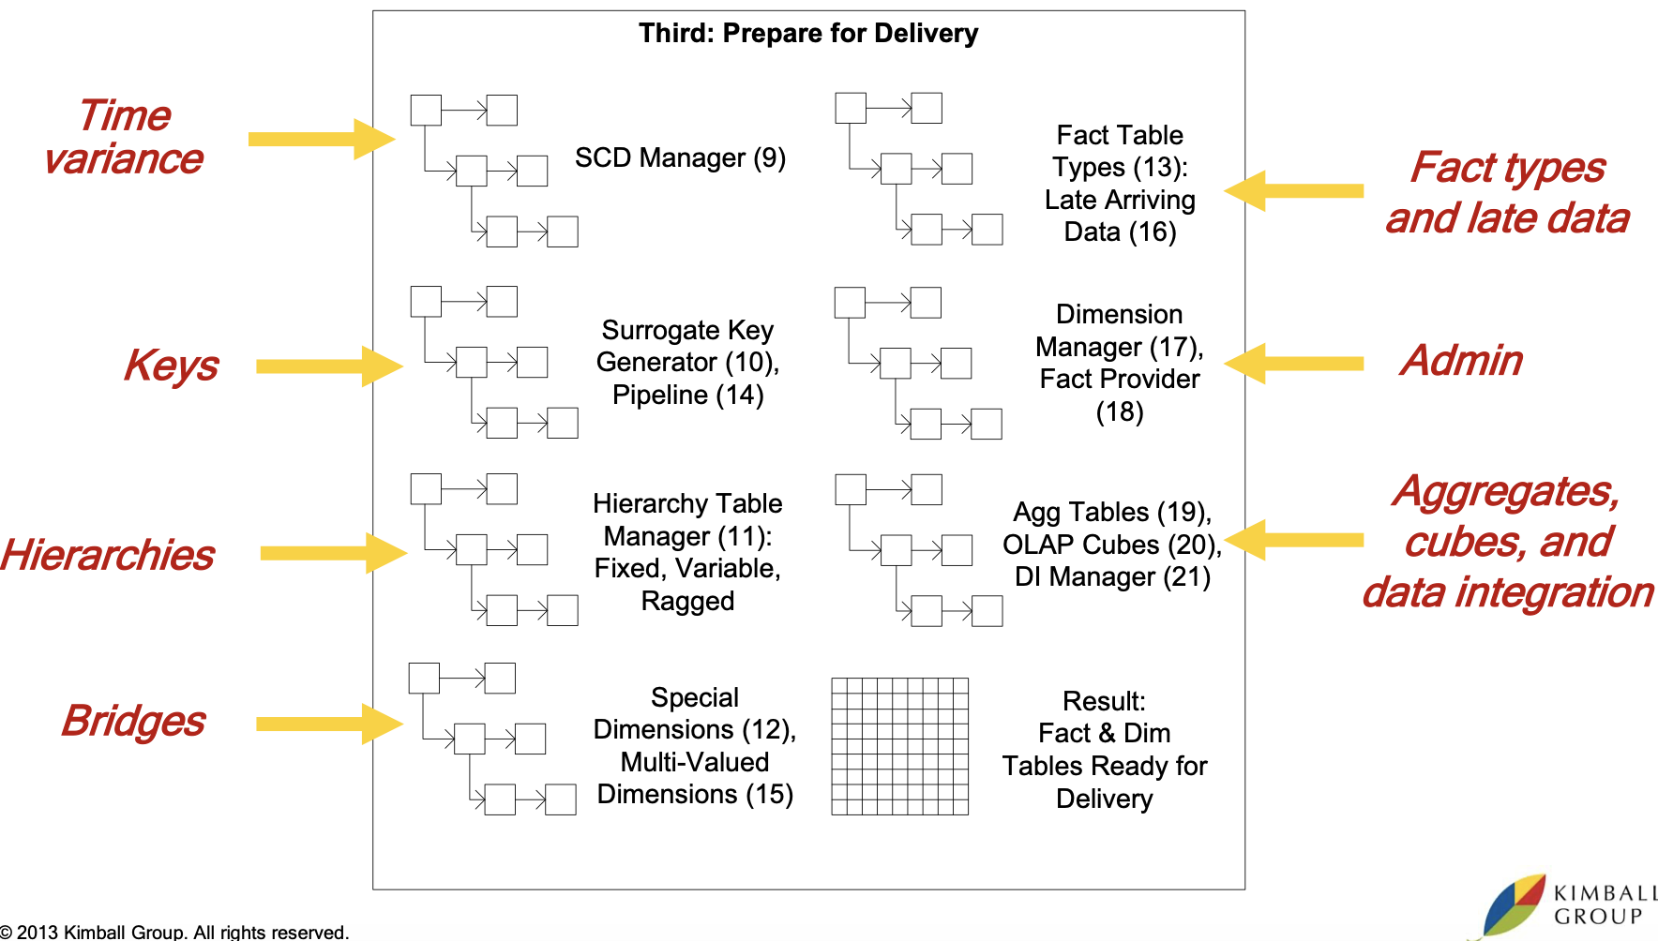
Subsystems of ETL: Delivering

Slide 27
Subsystems of ETL
﻿Managing the ETL Environment:
﻿Reliability. The ETL processes must consistently run. ﻿They must run t completion to provide data on a timely basis that is trustworthy at any level of detail.
﻿Availability. The data warehouse must meet its service level agreements (SLAs). ﻿The warehouse should be up and available.
﻿Manageability. A successful data warehouse is never done. It constantly grows and changes along with the business. ﻿The ETL processes need to gracefully evolve.

Slide 28
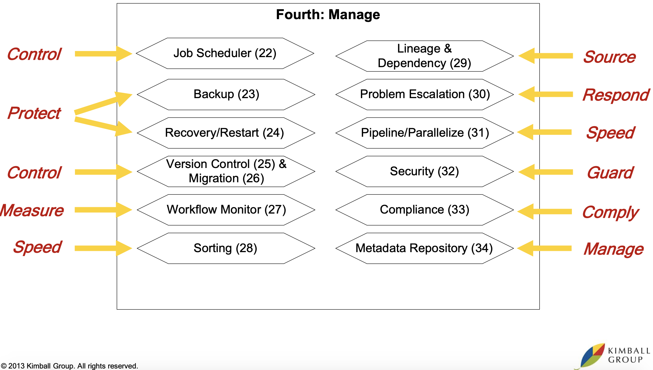
Subsystems of ETL: Managing the ETL Environment

Slide 29
What is an ETL tool?
Extract, Transform and Load (ETL)) is the process used to turn raw data into information that can be used for actionable business intelligence (BI).
An ETL tool is an instrument that automates this process by providing three essential functions:
Extraction of data from underlying data sources
Data transformation in order to meet the data model of enterprise repositories like data warehouses
Data loading into target destination

Slide 30






ETL tools available in the market
https://veribilimleri.wordpress.com/2017/03/30/etl-tools-comparison/

Slide 31
What is Talend Studio?
Talend Studio is an architecture for data integration, data profiling, big data, cloud integration and more.
It is a GUI environment that offers more than 1000 pre-built connectors.
This makes it easy to perform operations like transform files, load data, move and rename files.
It allows each component to define complex processes.
Integration jobs are created from components that are configured instead of coded.
Jobs can be run from within the development environment, or it can be executed as standalone scripts.

Slide 32
ETL Process Overview
Objective:
Outline ETL design and development process.
A “Recipe” for ETL
Before you begin, you’ll need
Physical Design – Star Schema implementation in OLAP, with initial load.
Architecture Plan – understanding of your DW/BI architecture.
Source to Target Mapping – Part of the detailed design process.

Slide 33
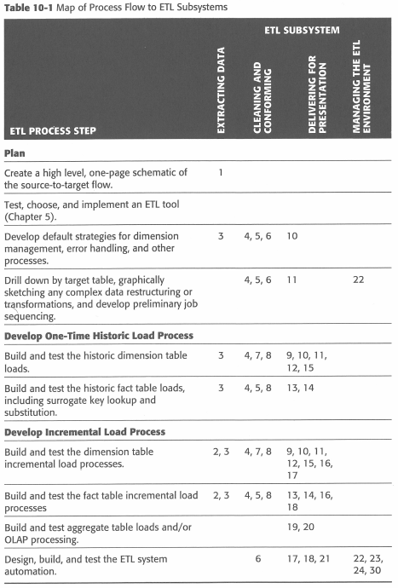
ETL Process Overview
The Plan…
How the 34 subsystems map and are related to the 10 step plan.
According to Kimball.

Slide 34
﻿Develop the ETL Plan
﻿Step 1: Draw the High-Level Plan
﻿Independent of any specific technology or approach.
﻿A simple one for communicating with people outside the team and a detailed version for internal DW/BI team documentation.
This is called a source to target map.
Sources come from a variety of disparate areas.
Targets are Dimension and Fact Tables

Slide 35
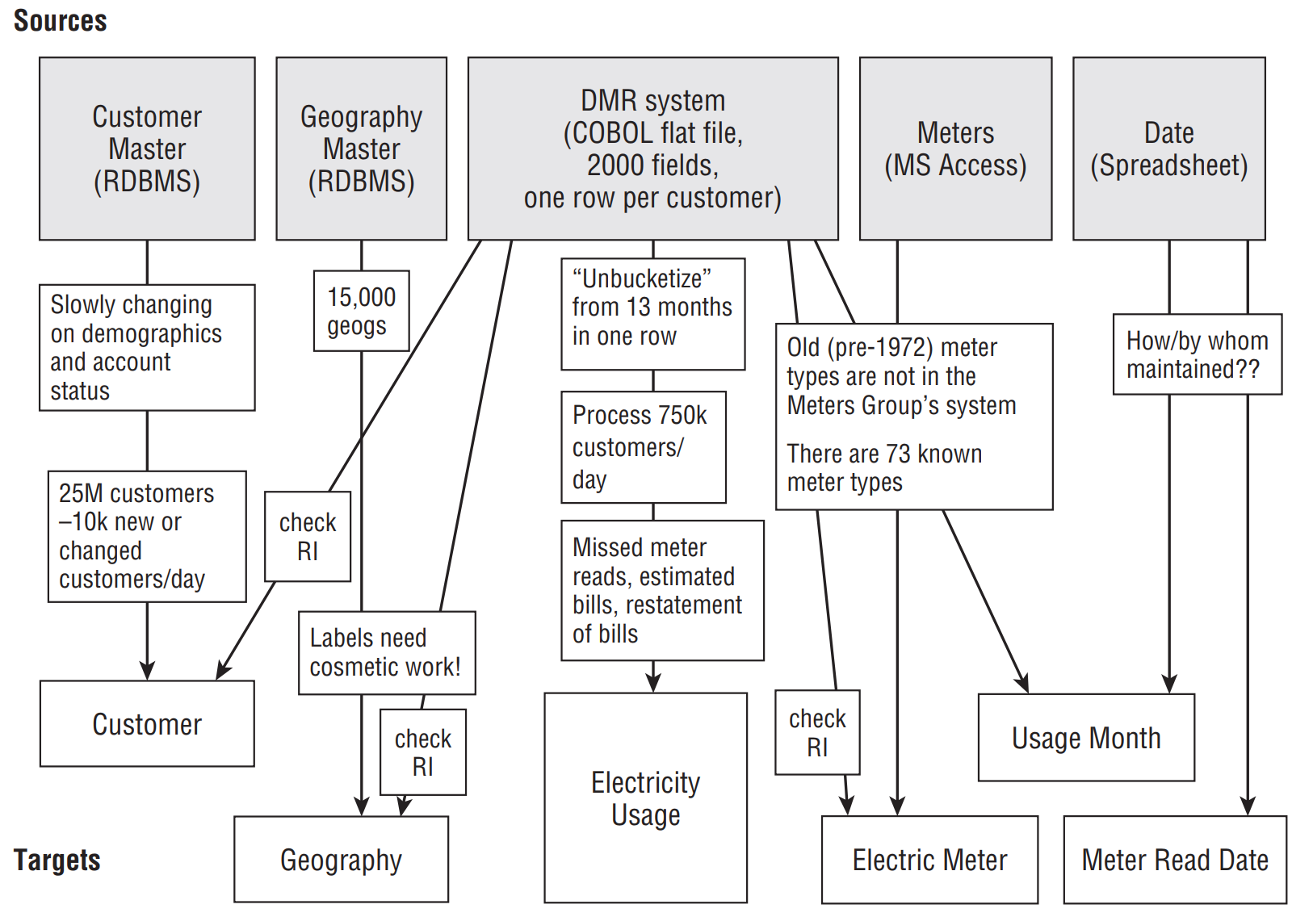
Develop the ETL Plan

Slide 36
Develop the ETL Plan
﻿Step 2: Choose an ETL Tool
ETL tool: read data from a range of sources, including flat files, ODBC, OLE DB, and native database drivers for most relational databases.
﻿Defining transformations on that data;
﻿Including lookups and other kinds of joins;
﻿Writing data into a variety of target formats;

Slide 37
Develop the ETL Plan
Your ETL tool is responsible for moving data from the various sources into the data warehouse.
Programming language vs. Graphical tool.
Programming ➔ Flexibility, Customizable
Graphical ➔ Self Documenting, Easy for beginners
The best solution is somewhere in the middle.

Slide 38
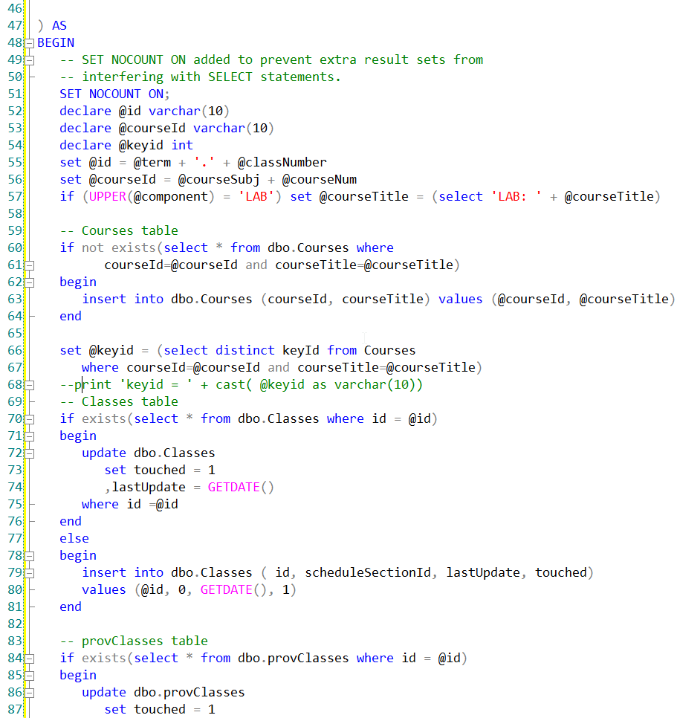
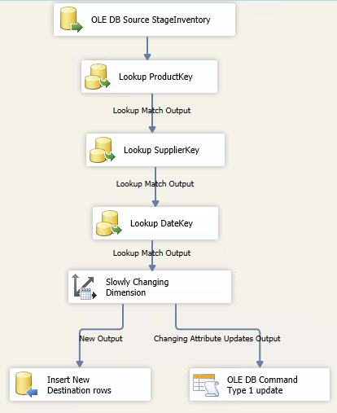
Develop the ETL Plan
ETL: Code vs Tool
Which of these is easier to understand?

Slide 39
Develop the ETL Plan
﻿Step 3: Develop Default Strategies
﻿Develop a set of default strategies for the common activities in the ETL system.
﻿a. Extract from each major source system.
﻿default method for extracting data from each source system.
b. Archive extracted and staged data.
archive extracted and staged data before it’s been transformed;
c. Police data quality for dimensions and particularly facts.
﻿Data quality must be monitored during the ETL process.

Slide 40
Develop the ETL Plan
d. Manage changes to dimension attributes.
e. Ensure the data warehouse and ETL system meet the system availability requirements.
﻿document when each data source becomes available and block out high-level job sequencing;
f. Design the data auditing subsystem.
﻿Each row in the data warehouse tables should be tagged with auditing information;
g. ﻿Organize the ETL staging area.
﻿data will be written to disk for a later ETL step and for system recovery and archiving;

Slide 41
Develop the ETL Plan
The Role of the Staging:
Staging stores copies of source extracts
This can be a Database or File Systems
Can create a history when none exists.
Reduces unnecessary processing of data source.
ETL: TRANSFORM (Tooling)
Data Sources
Staging File System or Database
Data Warehouse
EXTRACT
LOAD
ELT:TRANSFORM (SQL)

Slide 42
Develop the ETL Plan
﻿Step 4: Drill Down by Target Table
﻿Understand the necessary data transformations for each table and column.
﻿Ensure Clean Hierarchies -> whether hierarchical relationships in the dimension data are perfectly clean; The best source systems normalize;
﻿Develop Detailed Table Schematics -> the dimension tables must be processed before the key lookup steps for the fact table. The dimension tables are usually independent from each other;
﻿Develop a Sandbox Source System -> a static snapshot of the database for the ETL development team;

Slide 43
Develop the ETL Plan
Start drilling down into the detailed source to target flow for each target dimension and fact table
Flowcharts and pseudo code are useful for building out your transformation logic.
ETL Tools allow you to build and document the data flow at the same time:

Slide 44
﻿Develop One-Time Historic Load Processing
﻿Step 5: Populate Dimension Tables with Historic Data
Part of the one-time historic processing step.
Start with the simplest dimension table (usually type 1 SCD’s)
Transformations
Combine from separate sources
Convert data ex. EBCDIC ←→ ASCII
Decode production codes ex. TTT→ Track-Type Tractor
Verify rollups ex: Category → Product
Ensure a “Natural” or “Business” key exists for SCD’s
Assign Surrogate Keys to Dimension table

Slide 45
Develop One-Time Historic Load Processing
Step 6 – Perform the Fact Table Historic Load
Part of the one-time historic processing step.
Transformations:
Replace special codes (eg. -1) with NULL on additive and semi- additive facts
Calculate and store complex derived facts ex: shipping amount is divided among the number of items on the order.
Pivot rows into columns ex: account type, amount → checking amount, savings amount
Associate with Audit Dimension
Lookup Dimension Keys using Natural/Business Keys….

Slide 46
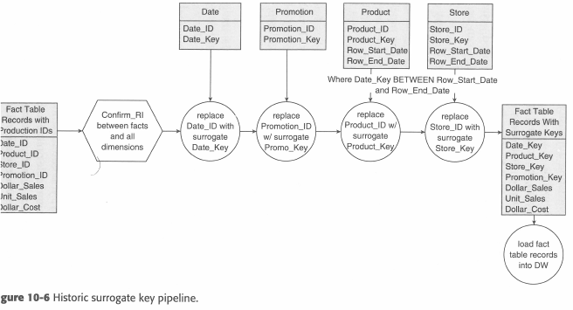
Develop One-Time Historic Load Processing
Example Surrogate Key Pipeline
Handles SCD’s

Slide 47
﻿Develop Incremental ETL Processing
Step 7 – Dimension Table Incremental Processing
Oftentimes the same logic used in the Historic load can be used.
Identify New/ Changed data based on different attributes for the same natural key
ETL tools usually can assist with this logic.
CDC (Change Data Capture) Systems are popular;

Slide 48
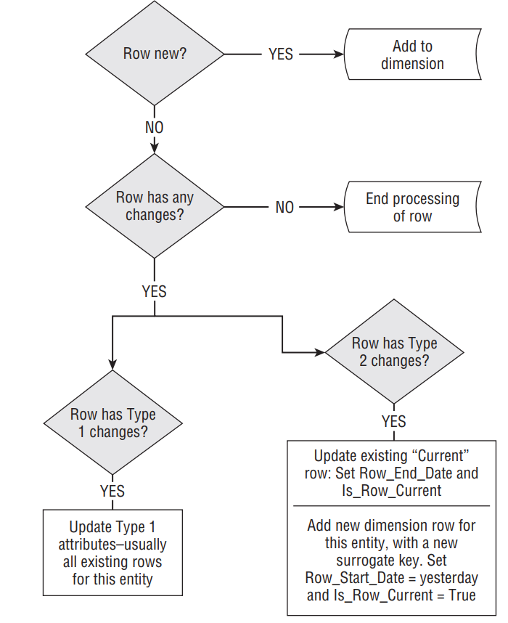
Logic flow for handling dimension updates

Slide 49
Develop Incremental ETL Processing
Step 8 – Fact Table Incremental Processing
A complex ETL:
Can be difficult to determine which facts need to be processed?
What happens to a fact when it is re-processed?
What if a dimension key lookup fails?
Some ETL tool assist with processing this logic.
Degenerate dimensions can be used ex: transaction number in order summary
A combination of dimension keys ex: StudentKey and ClassKey for grade processing.
CDC (Change Data Capture) Systems are popular;

Slide 50
CDC Change Data Capture
Data Change Events (Create, Update, Delete) are passed to the CDC System
The system acts as a source for the ETL Process
OLTP
Database Transaction Log
CDC
System
ETL Job
OR
Msg Queue / Service Bus

Slide 51
Develop Incremental ETL Processing
Step 9 – Aggregate Table and OLAP Loads
Further processing beyond the OLAP star schema.
Refresh / Reprocess
OLAP cubes
INDEXED / MATERIALIZED views
Aggregate summary tables

Slide 52
Develop Incremental ETL Processing
Step 10 – ETL System Operation & Automation
Schedule jobs
Catch and Log errors / exceptions
Database management tasks:
Cleanup old data
Shrink Database
Rebuild indexes
Update Statistics

Slide 53
﻿Real-Time Implications
﻿Real-Time Triage:
﻿Instantaneous means the data visible on the screen represents the true state of the source transaction system at every instant.
﻿When the source system status changes, the screen instantly and synchronously responds.
﻿Intra-day means the data visible on the screen is updated many times per day but is not guaranteed to be the absolute current truth.
﻿Daily means the data visible on the screen is valid as of a batch file download or reconciliation from the source system at the end of the previous working day.

Slide 54
Real-Time Implications
﻿Real-Time Architecture Trade-Offs
﻿The architectural choices involve trade-oﬀs that aﬀect data quality and administration.
﻿Limit Data Quality Screens -> ﻿eliminate more costly data quality screening, especially structure screens and business rule screens.
﻿Post Facts with Dimensions -> ﻿the facts arrive before the dimensions.
Eliminate Data Staging -> ﻿stream data directly from the production source system to the users’ screens without writing the data to permanent storage in the ETL pipeline.

